Slide 1
GUI prototype presentation

Slide 2
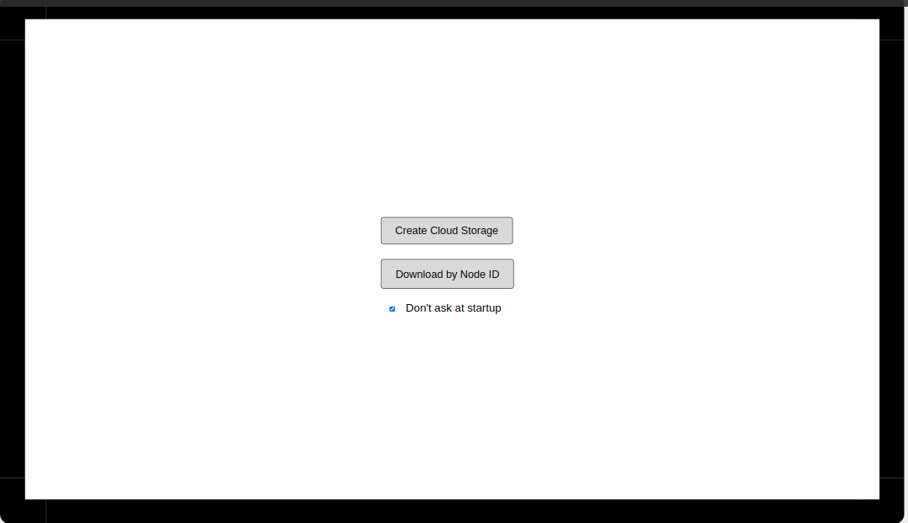
Starting window
After the user starts the application, a start window will appear in front of him.

Slide 3
The user is prompted to choose what action he wants to perform:
1. Create a separate node in the cloud file system
2. Download files from the cloud file system using a unique node identifier (Node ID).
There is also a checkbox on the window that is responsible for showing the start window at startup. If the "do not ask at startup" mode is selected, the window selected by the user will be immediately displayed in the future. For example, the window for creating a new node, if the user clicked "Create a new node" and activated the checkbox "Do not ask at startup".
In the future, this choice can be changed by going to the settings menu from any window of the subsequent program window.

Slide 4
Authorization Window
If the user proceeded to create a node in the file system, an authorization window with two buttons will appear before - log into an account and create an account.
Unregistered users are not allowed to create nodes.
I forgot to take a screenshot, so let's use our imagination :)

Slide 5
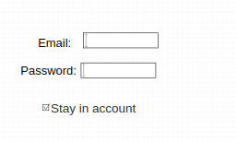
Log in Winow
If the user chose to log into an existing account, a login form will appear.
The form contains fields for entering the data required for authentication and the "Stay in account" checkbox. If the user has chosen to "stay in account", the login window will not appear on subsequent launches of the application until the user logs out.
This choice can be canceled in the program settings menu.

Slide 6
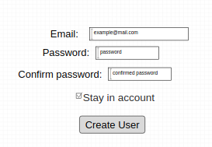
Sig in Window
If the user in the authorization window has chosen "create user", a new user registration window will appear in front of him. This window is similar to the account login window discussed on the previous slide.
If the "stay in account" checkbox is active, the user will be authorized under the newly created account, without unnecessary data entry.

Slide 7
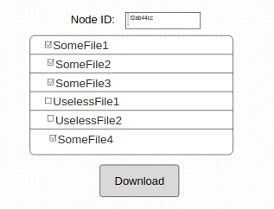
Download Window
Consider the window for downloading files by node ID. A field for entering the node identifier appears in front of the user. After the input is completed, the list of files located in this node is loaded. The user can click the "download" button and the selected files will be downloaded from the cloud storage to the user's personal computer.

Slide 8
Download Window
After clicking on the button, a dialog for choosing the directory for saving will appear. The default save directory can be configured from the setup menu.

Slide 9
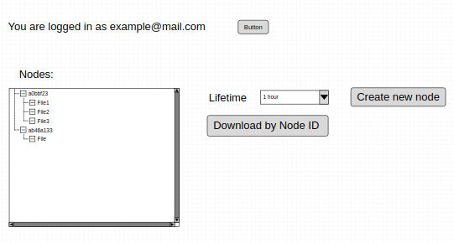
Node creating Window
When choosing to create a node, a window for creating nodes will appear in front of the user.

Slide 10
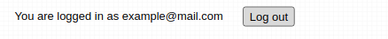
Node creating Window
The line with the authorization data shows the email used to log into the account, as well as the button to log out of the account.
When you click on this button, the window for creating a node will close and the data on the current user will be reset.
You can also go to the node loading window from this window by clicking on the corresponding button

Slide 11
Node creating Window
The key element of this window is the key for creating a new node, as well as a drop-down list for selecting the file lifetime
An equally important control element is the tree view of existing user nodes. By clicking the right mouse button on the node, a context menu will be called with the option to upload a file to the node.

Slide 12
Node creating Window
When you right-click on a file located in a node, a context menu will be called, which will allow the user to:
1. Remove file from node
2. Get file information

Slide 13
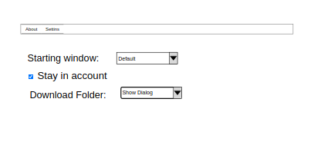
Settings window
You can get to this window by pressing the corresponding key in the tool menu of the windows for creating and loading nodes. This window will allow you to configure the program parameters, such as:
1. Start window of the program
2. Whether the user should remain in the account after authorization
3. The path for downloading files by default, instead of choosing at each download

Slide 14
Thanks for your attention!
The author hopes that the designed interface is simple and intuitive. The design of the application can be changed while working on the project.

